Slide 1

Vishwakarma Institute of Technology, Pune
Road Surface Classification and Object Detection
Authors: Dr. Shripad Bhatlawande, Yash Aney, Vedant Anantwar, Aatreya Gaikwad, Prof. Jyoti Madake, Dr. Swati Shilaskar
International Conference on Recent Advances in Computational Techniques 2022
Hosted by: Amity School of Engineering and Technology, Mumbai

Slide 2
Introduction:
1
Independent And Safe Mobility Is Still A Challenge For Visually Impaired People.
Electronic Travel Aids can Address Their Mobility related Difficulties.

Slide 3
Literature Review:
2
Existing assistive blind aids and solutions present currently.

Slide 4
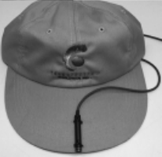
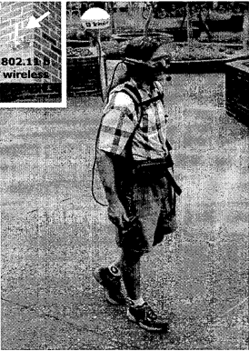
Literature Review:
vOICe
It was a sonic imaging system for the VI. It is a wearable device. The voice has proved out to be very useful to the VI(Visually Impaired) the only limitation to this though is the fact that the time span to learn and master the device was very long.
Photodiode Cane
a device proposed by Joselin Villanueva which was a handheld device used to detect the correct path for the VI to walk through.
Sonic Torch
utilize FM signals which would calculate/generate the distance of the object by the generated sound’s pitch

Slide 5
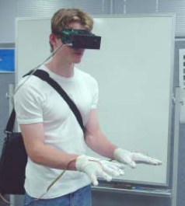
Literature Review:
CyARM
a hand-held device that used ultrasound sensors to detect things on the ground and in the air
Navigation Assistant for Visually Impaired
The VS (Vision sensor) would capture information in the sight of the VI. After that, the picture was analyzed in order to determine the item in front of the individual
2-D Display
worked by closely packed electrodes pulsating giving the VI an idea about the image was made by Kaczmarek. IT was named after his name Kaczmarek’s electro tactile display which had simply packed black and white pixels onto a matrix

Slide 6
Literature Review:
Wearable Navigation System
A wearable that helped to assist the person with indoor surroundings. It used Arduino Microcontroller as the brain and a very cheap camera as a CV (Computer Vision) camera along with several vibration motors to give out feedback
Navigation and Narration system for the Blind
a device that had an ImageNet dataset that was trained and worked on a neural network that was convolution in nature.

Slide 7
Research Gap:
3
Steep Learning Curve.
Difficult To Operate
Obstacle Detection Range: 2-12m
Information Overload.

Slide 8
Proposed Solution:
4
Realtime superintendence and surveillance.
It consists of four modules:
A) Drone Based Superintendence.
B) Temperature Sensor LM35 series.
(Calibrated in Kelvin)
C)Humidity Sensor.
(DHT22, Alias AM2302)
D)Robocraze HC05.
(Bluetooth Transceiver Module with TTL Outputs)
Alerts using auditory commands and vibration signals.

Slide 9
Novelty:
5
Higher accuracy by implementation of RTH index Metric.
Easier Decentralized Deployment.
Lower computational expenses.
Portable and Hybrid low powered arduino system.
Can be deployed on solid platforms as well.
Detects Fire in the range of up to 4 m to avoid information overloading.

Slide 10
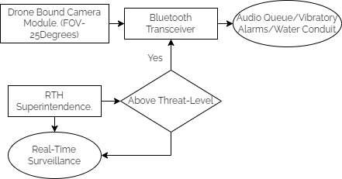
Forest Terrain Superintendence.

Slide 11
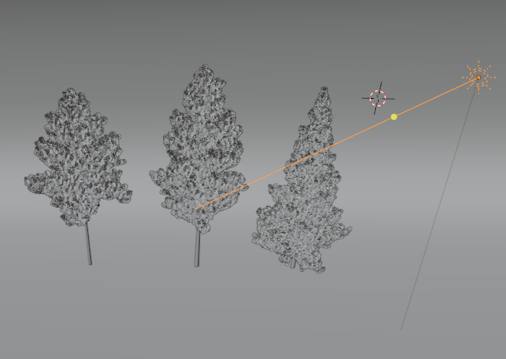
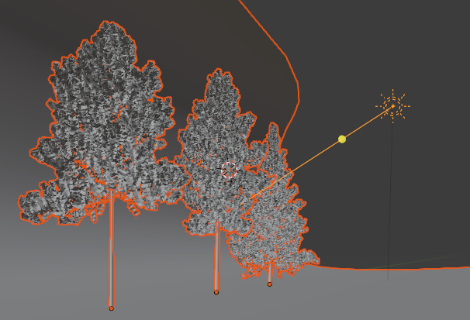
Demonstrational Info-Graphics
Superintendence Vectors from the Deployed Drone upon activation.

Slide 12
1) Dataset
Sr. No. | Type | No. of Images | Class
1 | Cement Road With Obstacles | 2000 | 0
2 | Cement Road without Obstacles | 2000 | 1
3 | Tar Road with Obstacles | 2000 | 2
4 | Tar Road Without Obstacles | 2000 | 4

Slide 13
Data Pre-processing:
Gray scaling the image
Resizing the images to 400 x 200 pixels.
Histogram equalization of images
Global Thresholding
Sharpening the images
Cropping from 50 px to 400 px row-wise

Slide 14
Feature Extraction: SIFT
Scale Invariant feature transform (SIFT).
Advantages of SIFT:
Rotational Invariant
Scale Invariant
Occlusion Immunity
Performs better in non-uniform illumination
Img. 1
SIFT features of Img. 1
SIFT Feature Vector
4895612x128
Img. 2
SIFT features of Img. 2
Img. 8000
SIFT features of Img. 8000
Module 1: Obstacle Detection

Slide 15
Compilation of Optimized Feature Vector:
Output SIFT Feature Vector: 48,95,612x128
Novel Blend of K-Means and PCA
K-Means: Dividing Feature Vector in 26 clusters (8,000x26)
Prediction performed on Pretrained K-Means Clustering Model.
PCA: Optimize Feature Vector to 8,000x20
Module 1: Obstacle Detection

Slide 16
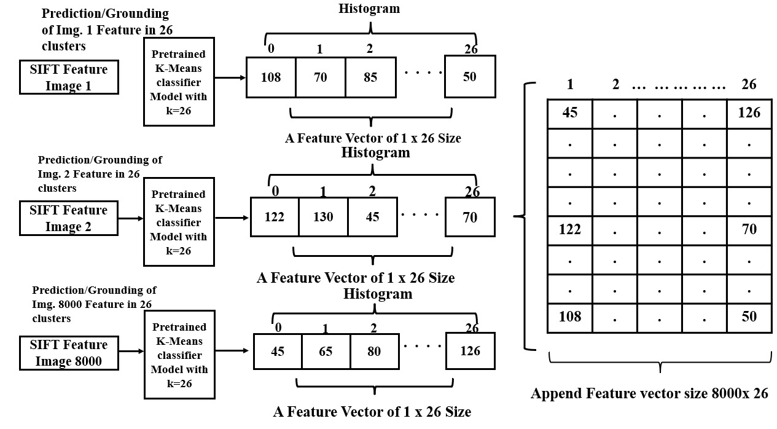
K-Means:

Slide 17
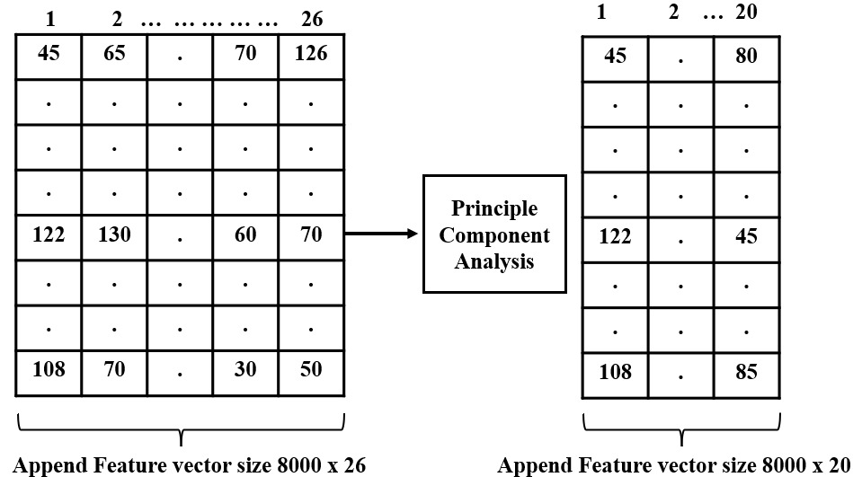
Principal Component Analysis (PCA):

Slide 18
Classification:
Four Supervised machine learning classifiers were used for classification:
KNN
Random Forest
Decision Tree
SVM (RBF)
Dataset Split: 80% Training and 20% Testing

Slide 19
Performance Evaluation:
Classifiers | Training Accuracy (%) | Precision | Recall | F1 score
KNN | 83.99 | 0.840 | 0.835 | 0.834
Random Forest | 88.47 | 0.885 | 0.881 | 0.881
Decision Tree | 82.65 | 0.827 | 0.823 | 0.823
SVM | 86.10 | 0.861 | 0.857 | 0.856

Slide 20
Comparison:
Name | Technique | Form | Feedback
vOICe | Sonic Imaging | Wearable | Auditory
Photodiode cane | Photodiode | Cane | Tactile
Teletact | Laser Technology | Handheld | Tactile
NAVI | Image Processing and Fuzzy Algorithms | Wearable device | Auditory
Proposed System | Computer Vision | Cane | Auditory

Slide 21
Conclusion:
The System recognizes road surfaces (cement/tar).
Object Detection Provides Auditory Feedback On Detection Of Objects.
detects obstacles in the range up to 4 m.
Accuracies:
KNN: 83.99%
Random Forest: 88.47
Decision Tree: 82.65%
SVM: 86.10 %
Image Quality and Darkness is A Concern

Slide 22
References:
Meers, Simon, and Koren Ward. "A vision system for providing 3D perception of the environment via transcutaneous electro-neural stimulation." In Proceedings. Eighth International Conference on Information Visualisation, 2004. IV 2004., pp. 546-552. IEEE, 2004.
http://sonicvision.co.nz/ May.
Dakopoulos, Dimitrios, and Nikolaos G. Bourbakis. "Wearable obstacle avoidance electronic travel aids for blind: a survey." IEEE Transactions on Systems, Man, and Cybernetics, Part C (Applications and Reviews) 40, no. 1 (2009): 25-35.
Kuc, Roman. "Binaural sonar electronic travel aid provides vibrotactile cues for landmark, reflector motion and surface texture classification." IEEE transactions on biomedical engineering 49, no. 10 (2002): 1173-1180.
Villanueva, Joselin, and René Farcy. "Optical device indicating a safe free path to blind people." IEEE transactions on instrumentation and measurement 61, no. 1 (2011): 170-177.

Slide 23
References:
Farcy, René, Roger Leroux, Alain Jucha, Roland Damaschini, Colette Grégoire, and Aziz Zogaghi. "Electronic travel aids and electronic orientation aids for blind people: technical, rehabilitation and everyday life points of view." In Proceedings of the Conference and Workshop on Assistive Technology for Vision and Hearing Impairment. 2006.
Kay, L. "Electronic aids for blind persons: an interdisciplinary subject." IEE Proceedings A (Physical Science, Measurement and Instrumentation, Management and Education, Reviews)131, no. 7 (1984): 559-576.
Kay, Leslie. "Auditory perception of objects by blind persons, using a bioacoustic high resolution air sonar." The Journal of the Acoustical Society of America 107, no. 6 (2000): 3266-3275.
Liu, Jihong, and Xiaoye Sun. "A survey of vision aids for the blind." In 2006 6th World Congress on Intelligent Control and Automation, vol. 1, pp. 4312-4316. IEEE, 2006.
Ito, Kiyohide, Makoto Okamoto, Junichi Akita, Tetsuo Ono, Ikuko Gyobu, Tomohito Takagi, Takahiro Hoshi, and Yu Mishima. "CyARM: an alternative aid device for blind persons." In CHI'05 Extended Abstracts on Human Factors in Computing Systems, pp. 1483-1488. 2005.

Slide 24
Thank You!
International Conference on Recent Advances in Computational Techniques 2022
Hosted by: Amity School of Engineering and Technology, Mumbai

